Slide 1
Chapter 7
Wind Power Systems

Slide 2
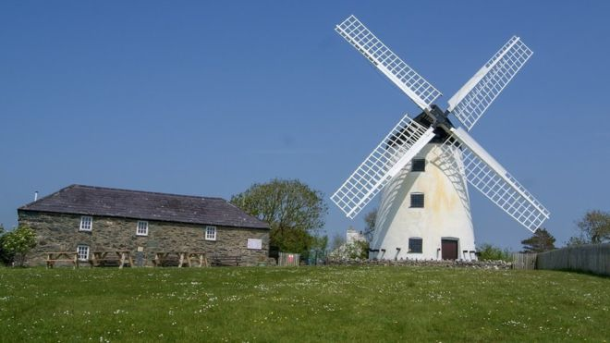

Historical development of wind power
Wind has been utilized as a source of power for thousands of years. Most early wind turbines were used to grind grain into flour, hence the name “windmill.”

Slide 3
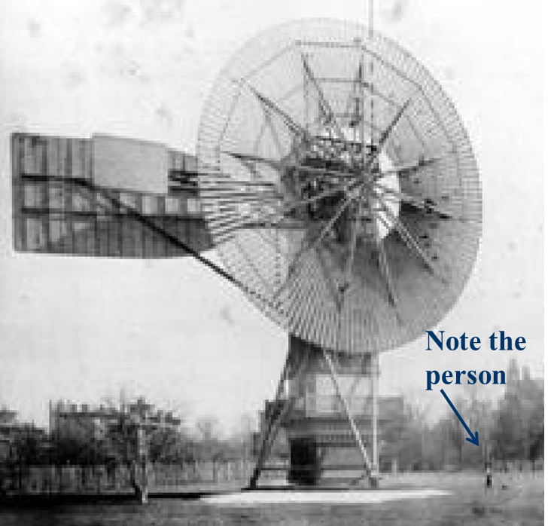
Historical development of wind power
In the United States, the first wind-electric systems were built by Charles F. Brush turbine, in Cleveland, Ohio in 1888

Slide 4
Historical development of wind power
In the US - first wind-electric systems built in the late 1890’s
By 1930s and 1940s, hundreds of thousands were in use in rural areas not yet served by the grid
Interest in wind power declined as the utility grid expanded and as reliable, inexpensive electricity could be purchased
Oil crisis in 1970s created a renewed interest in wind until US government stopped giving tax credits
Renewed interest again since the 1990s

Slide 5
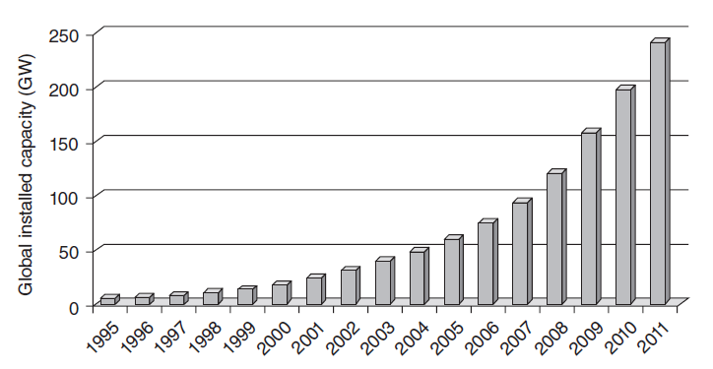
Historical development of wind power
Global installed capacity of wind turbines

Slide 6
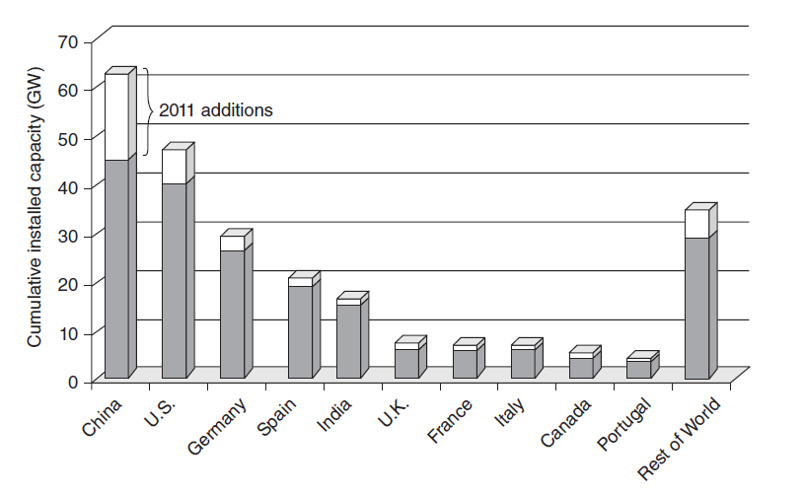
Historical development of wind power
Total installed capacity by the beginning of 2012

Slide 7
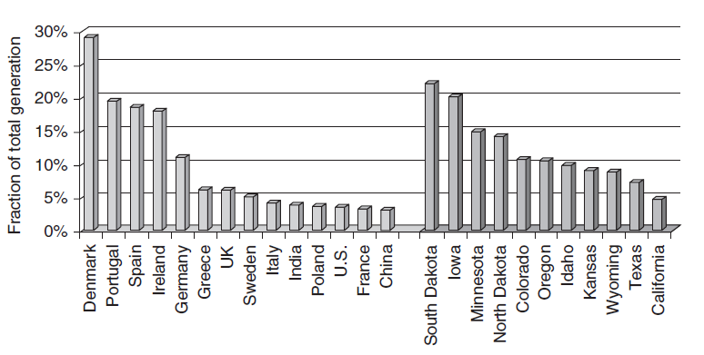
Historical development of wind power
Fraction of total generation provided by wind in countries and states

Slide 8
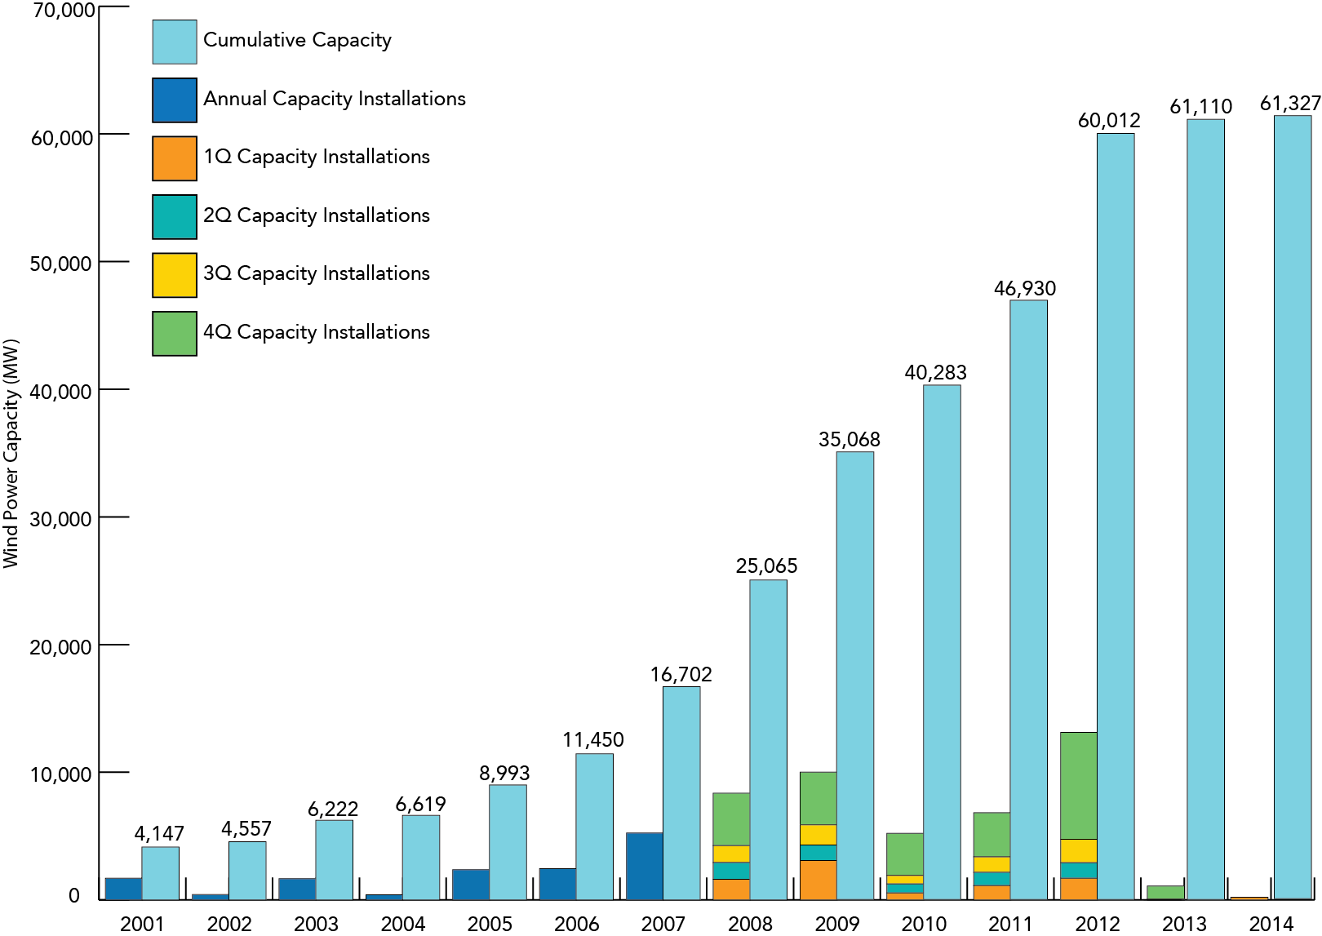
Historical development of wind power
Growth in US Wind Power Capacity

Slide 9
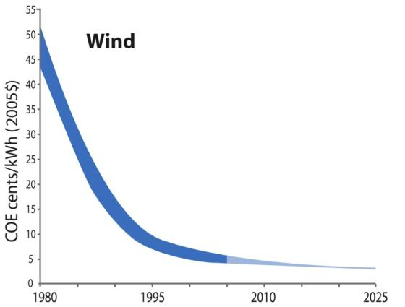
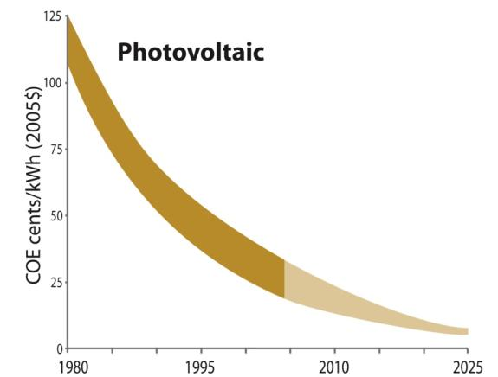
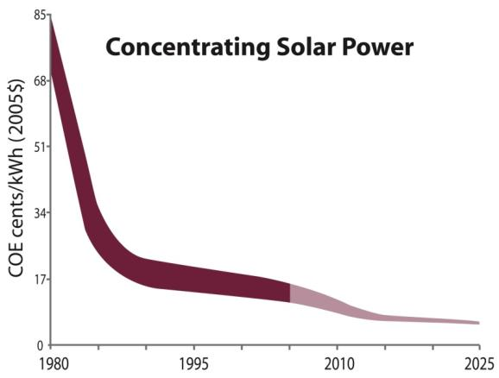
Historical Change in Wind Economics, Constant 2005 Dollars
Source: National Renewable
Energy Lab (NREL), Energy
Analysis Office

Slide 10
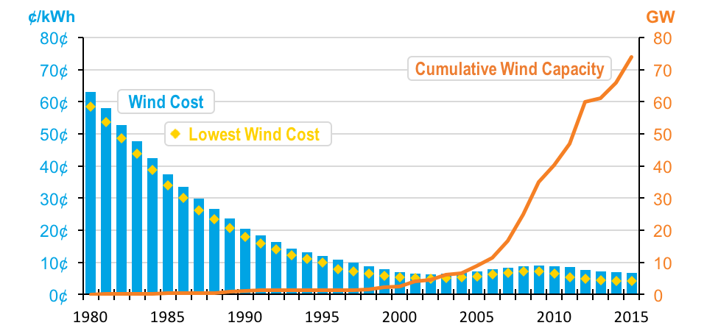
Wind energy price
The price for wind farm decreases a lot over the last decades.

Slide 11
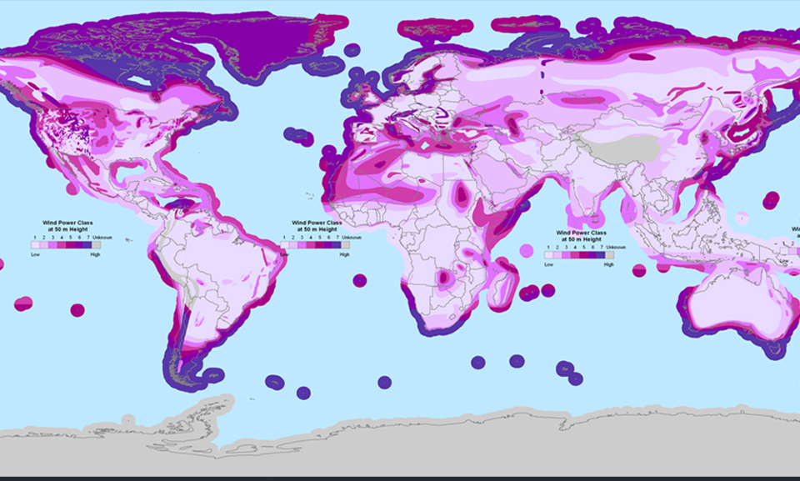
Worldwide Wind Resource Map
In this map you see the wind energy potential around the world. Wind is a bountiful resource all over, especially in coastal areas, where a lot of people live.

Slide 12
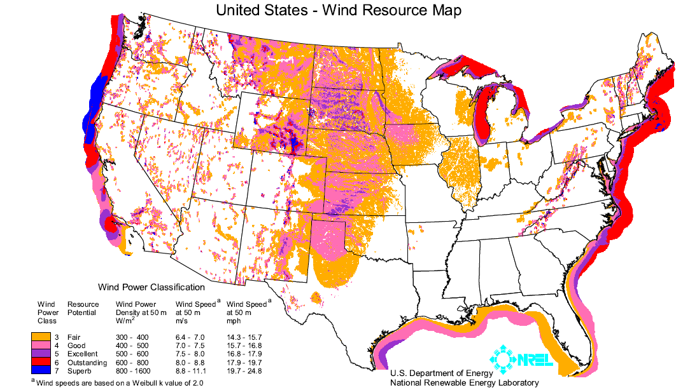
US Wind Resources
http://www.windpoweringamerica.gov/pdfs/wind_maps/us_windmap.pdf
http://www.windpower.org/en/pictures/lacour.htm
Notes:
12

Slide 13
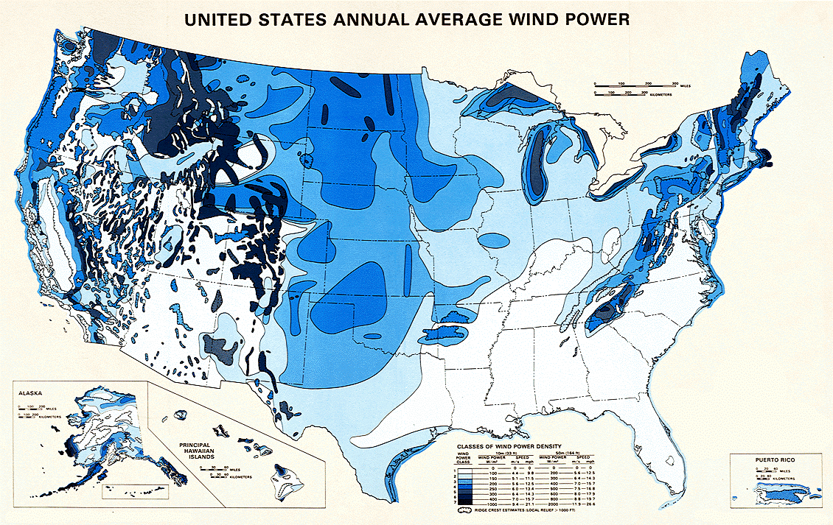
US annual average wind power
Source: NREL
Notes:
13

Slide 14
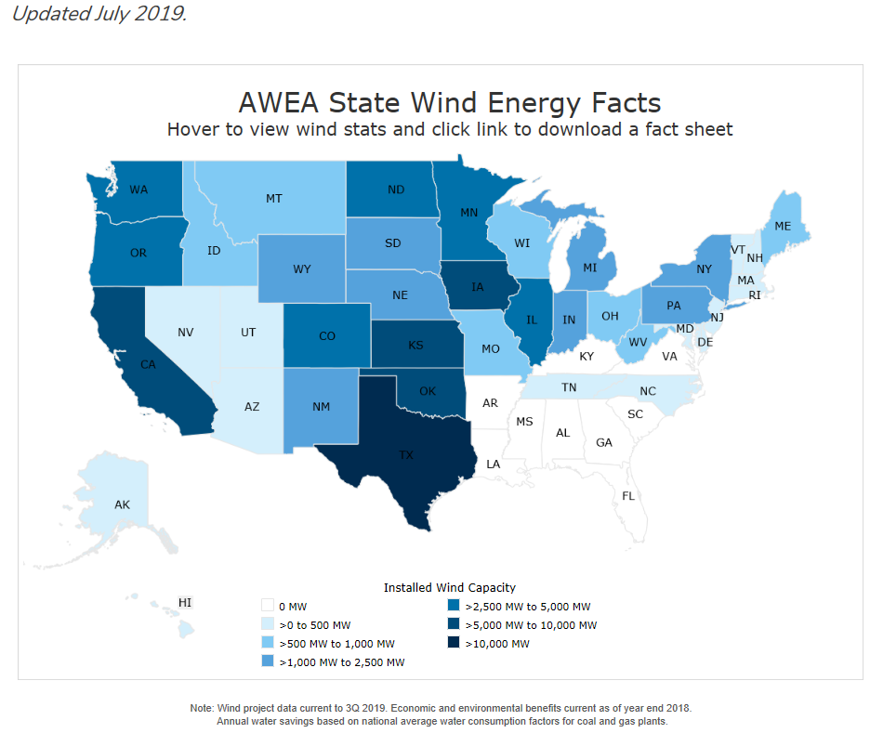
US current installed wind energy

Slide 15
Types of Wind Turbines
“Windmill”- used to grind grain into flour
Many different names - “wind-driven generator”, “wind generator”, “wind turbine”, “wind-turbine generator (WTG)”, “wind energy conversion system (WECS)”
Can have horizontal axis wind turbines (HAWT) or vertical axis wind turbines (VAWT)
Groups of wind turbines are located in what is called either a “wind farm” or a “wind park” or “wind power plant”
Notes:
15

Slide 16
Types of Wind Turbines
Classification: based on the axis around which the turbine blades rotate.
Upwind HAWT: Horizontal axis (requires yaw control)
Downwind HAWT: Horizontal axis; self yaw ctrl; wind shadowing
VAWT: Vertical axis (Darrieus); no need for yaw ctrl, nacelle on the ground, lightened tower; low wind speed
Terminology – nacelle: the housing around the generator, gear box, and other mechanical components
Terminology – yaw control: orien the blades facing into the wind direction
Number of rotating blades: rotational speed; modern turbines have 2 or 3 blades.
Notes:
16

Slide 17
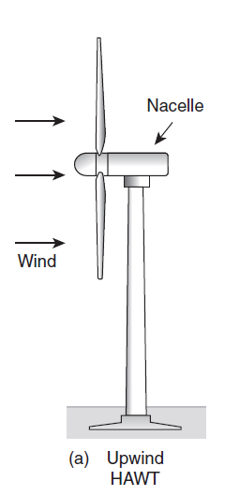
Types of Wind Turbines
Upwind HAWT: Horizontal axis:
Upwind turbines require somewhat complex yaw control systems to keep the blades facing into the wind. In exchange for that added complexity, however, upwind machines operate more smoothly and deliver more power. Essentially all modern wind turbines are of the upwind type.
Notes:
17

Slide 18
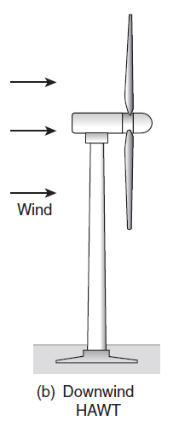
Types of Wind Turbines
Downwind HAWT:
A downwind machine has the advantage of letting the wind itself control the yaw (the left–right motion) so it naturally orients itself correctly with respect to wind direction.
They do have a problem with wind shadowing effects of the tower. Every time a blade swings behind the tower it encounters a brief period of reduced wind, which causes the blade to flex.

Slide 19
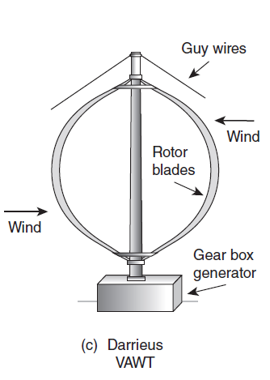
Types of Wind Turbines
VAWT: Vertical axis (Darrieus)
Vertical axis wind turbines (VAWTs) accept the wind from any direction.
the heavy generator and gearbox contained in the nacelle can be located down on the ground.

Slide 20
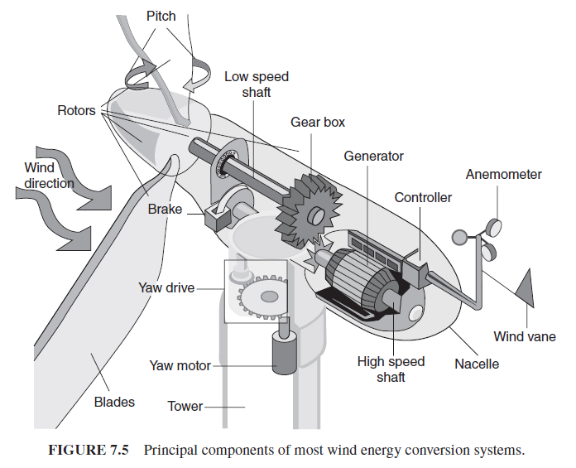
Key components to a wind energy conversion system
Blades convert kinetic energy in the wind into rotating shaft power to spin a generator that produces electric power.
gearbox transfers power from the low speed shaft to a higher speed shaft that spins the generator

Slide 21
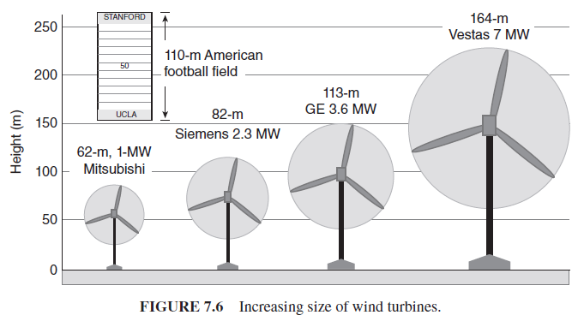
Wind turbine technology: rotors
In the last decades, turbines not only gotten much bigger, but also their efficiencies have improved significantly as well.

Slide 22
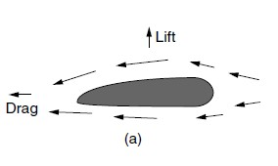
Wind turbine blades
Airfoil – could be the wing of an airplane or the blade of a wind turbine,
Bernoulli’s Principle - air pressure on top is lower than air pressure on bottom because it has further to travel, creates lift

Slide 23
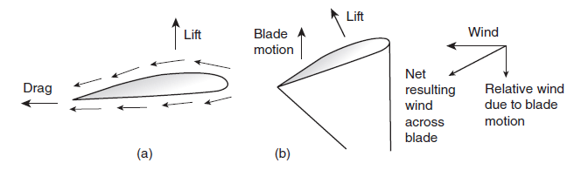
Wind turbine blades
The combination of wind and blade motion is like adding two vectors, with the resultant moving across the airfoil at the correct angle to obtain lift that moves the rotor along.

Slide 24
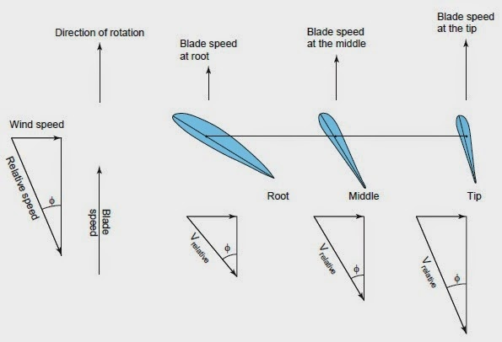
Wind turbine blades
Since the blade is moving much faster at the tip than near the hub, the blade must be twisted along its length to keep the angles right.

Slide 25
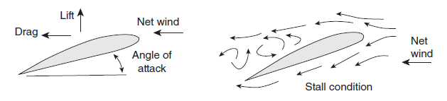
Wind turbine blades
Increasing the angle of attack too much can result in a phenomenon known as stall. When a wing stalls, the airflow over the top no longer sticks to the surface and the resulting turbulence destroys lift.
When an aircraft climbs too steeply, stall can have tragic results. In a wind turbine, this can be a good thing for wind power control.

Slide 26
Wind turbine technology: rotors
Wind Turbine Rotor Blades Speed Control:
At some wind speed, the generator reaches its maximum capacity at which point there must be some way to shed some of the wind’s power or else the generator may be damaged.
Three methods for safe power control in wind turbines:
  Stall regulation (passive)
  Active Pitch Control
  Active stall control

Slide 27
Passive Stall Regulation
The machine rotor blades are carefully designed aerodynamically to automatically reduce efficiency at excessive winds. The rotor blade twist is deigned to vary as a function of distance from the hub so that a gradual reduction in lift occurs at higher rotor rpm.
“Stall” means the turbulence on the side of the rotor blade not facing the wind is created gradually rather than abruptly when the wind speed reaches its critical value.

Slide 28
Active Pitch Control
An electronic controller checks the output power several times per second. When the output power is too high, it sends an order to the blade pitch mechanism to change orientation with wind direction (rotate the blades about their axis, slightly out of the wind). The rotor blades are kept at an optimum angle (of attack) by the pitch controller.

Slide 29
Active Stall Control
For large turbine (> 1MW), when winds exceed the rated windspeed, instead of reducing the angle of attack of the blades, it is increased to induce stall.
A combination of a stall regulated blade that can be pitched
Lower forces than only stall regulation, but is supposed to be more accurate in power regulation.

Slide 30
Wind turbine technology: generators

Slide 31
Wind turbine technology: generators
Wind generator types:
DC generators: small, battery-charging wind turbines.
AC synchronous generators: (1) precise rotational speed determined by the number of poles and grid frequency; (2) magnetic fields created on rotor (DC exciter, slip rings, brushes) maintenance cost; (3) gear box matching the required speeds.
AC asynchronous induction generator: (1) magnetic fields created on stator; less maintenance; (2) slip: (Ns-Nr) / Ns. About 1%; (3) two ways of starting magnetization in the induction generator: grid-connected, external capacitor.
- Squirrel cage induction generator.
- wound-rotor induction generator: (1) variable speed with fixed rotor resistors; (2) doubly-fed.

Slide 32
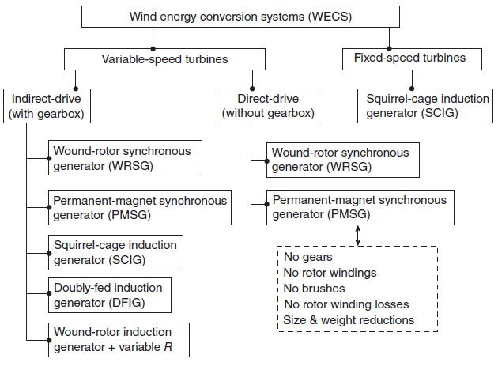
System configurations for wind energy systems
the range of wind system configurations that are all currently in use.

Slide 33
Fixed-Speed Synchronous Generators
Spin at a rotational speed determined by the number of poles and by the frequency
The magnetic field is created on their rotors
Create the magnetic field by running DC through windings around the core
A gear box is needed between the blades and the generator
2 complications – need to provide DC, need to have slip rings on the rotor shaft and brushes

Slide 34
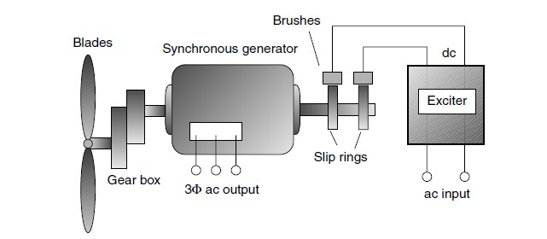
Fixed-Speed Synchronous Generators
A three-phase synchronous generators needs dc for the rotor windings, which usually means that slip rings and brushes are needed to transfer that current to the rotor from the exciter.

Slide 35
Asynchronous Induction Generators
Do not turn at a fixed speed
Acts as a motor during start up as well as a generator
Do not require exciter, brushes, and slip rings
The magnetic field is created on the stator instead of the rotor
Less expensive, require less maintenance
Most wind turbines are induction machines

Slide 36
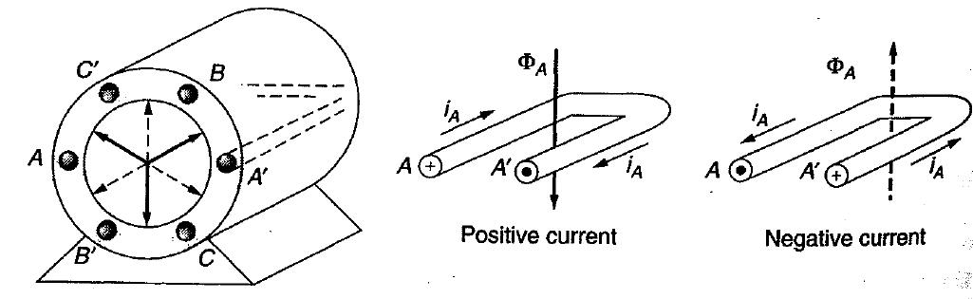
Rotating Magnetic Field
Imagine coils in the stator of this 3-phase generator
Positive current i_{A} flows from A to A’
Magnetic fields from positive currents are shown by the bold arrows

Slide 37
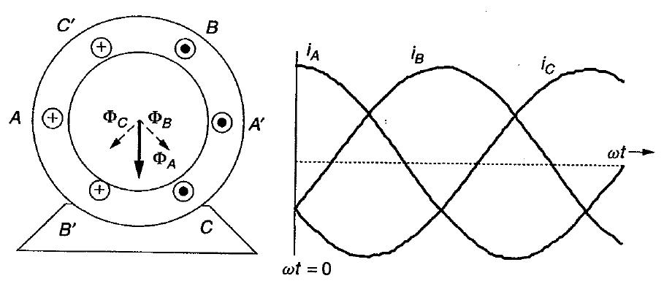
Rotating Magnetic Field
Three-phase currents are flowing in the stator
At ωt = 0, i_{A} is at the maximum positive value and i_{B}=i_{C} are both negative

Slide 38
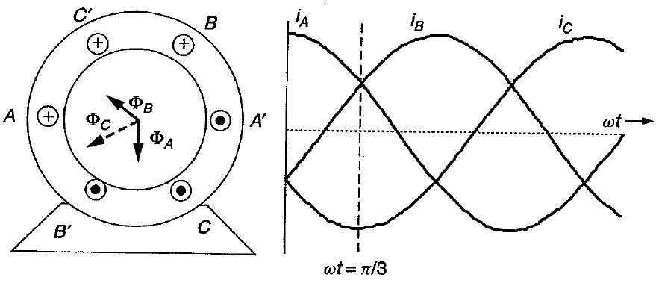
Rotating Magnetic Field
Three-phase currents are flowing in the stator
At ωt = π/3, iC is at the maximum negative value and iA=iB are both positive

Slide 39
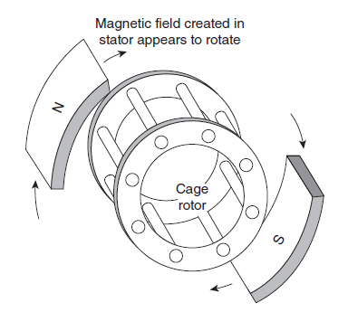
The Squirrel-Cage Induction Generator
The rotor of many induction generators has copper or aluminum bars shorted together at the ends, looks like a cage.
  Can be thought of as a pair of magnets spinning around a cage
  Rotor current i_{R} flows easily through the thick conductor bars

Slide 40
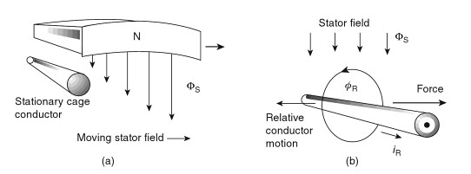
The Squirrel-Cage Induction Generator
In (a), the stator field moves toward the right while the cage rotor conductor is stationary. As shown in (b), that is equivalent to the stator field being stationary while the conductor moves to the left, cutting the lines of flux. The conductor then experience a force toward the right that tries to make the rotor want to catch up to the stator’s rotating magnetic field.

Slide 41
The Inductance Machine as Motor
The rotating magnetic field in the stator causes the rotor to spin in the same direction
As rotor approaches synchronous speed of the rotating magnetic field, the relative motion becomes less and less
If the rotor could move at synchronous speed, there would be no relative motion, no current, and no force to keep the rotor going
Thus, an induction machine as a motor always spins somewhat slower than synchronous speed

Slide 42
The Inductance Machine as Motor
The relative speed between the stator magnetic field and the rotor itself is called the slip speed s, defined as
Where N_{S} is the no-load synchronous speed and N_{R} is the rotor speed. Slip is defined to be positive when the rotor is moving at a slower speed than the stator’s rotating magnetic field; that is, when the machine is acting as a motor. When the rotor moves faster than the rotating magnetic field, slip is negative, and the machine becomes a generator.

Slide 43
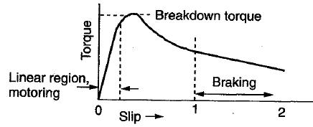
The Induction Machine as Motor
As load on motor increases, rotor slows down
When rotor slows down, slip increases
“Breakdown torque” increasing slip no longer satisfies the load and rotor stops
Braking- rotor is forced to operate in the opposite direction to the stator field
Torque- slip curve for an induction motor

Slide 44
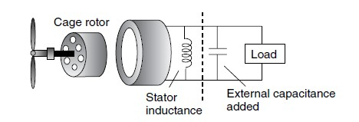
The Induction Machine as a Generator
The stator requires excitation current
  from the grid if it is grid-connected or
  by incorporating external capacitors
Windspeed forces generator shaft to exceed synchronous speed
Single-phase, self-excited, induction generator

Slide 45
The Induction Machine as a Generator
Slip is negative because the rotor spins faster than synchronous speed
Slip is normally less than 1% for grid-connected generator
Typical rotor speed

Slide 46
Doubly-Fed Induction Generators
Another common approach is to use what is called a doubly-fed induction generator in which there is an electrical connection between the rotor and supply electrical system using an ac-ac converter
This allows operation over a wide-range of speed, for example 30% with the GE 1.5 MW and 3.6 MW machines

Slide 47
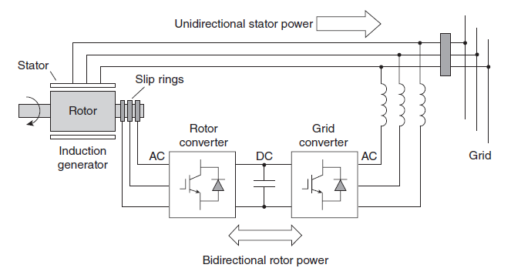
Doubly-Fed Induction Generators
A wound-rotor, doubly-fed induction generator (DFIG)

Slide 48
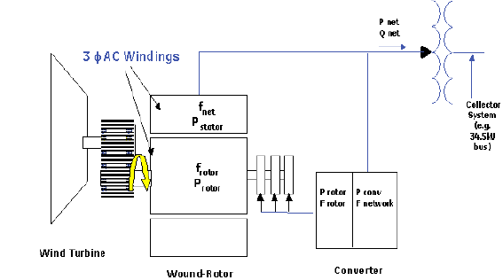
GE 1.5 MW and 3.6 MW DFIG Examples
GE 1.5 MW turbines are the best selling wind turbines in the US with 43% market share in 2008
Source: GE Brochure/manual

Slide 49
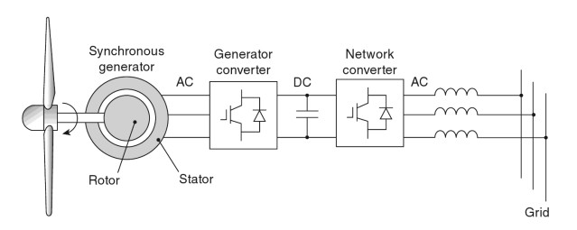
Wind Turbine Technology: Generators
Variable-Speed Synchronous Generator
A gearless, variable-speed synchronous generator with full-capacity convertors

Slide 50
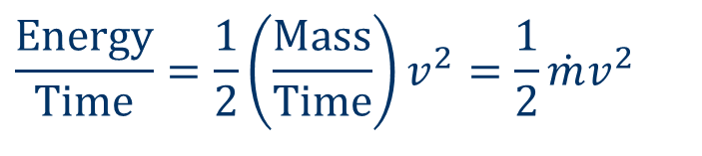
Power in the wind
Wind power is proportional to V³, Why?
Consider a “packet” of air with mass m moving at speed v. Its kinetic energy, K.E.,:
Power is energy per unit time, so the power represented by a mass of air moving at a velocity v thru area A will be:
m
$$\frac{\text{Energy}}{\text{Time}}=\frac{1}{2}\left(\frac{\text{Mass}}{\text{Time}}\right)v^{2}=\frac{1}{2}\dot{m}v^{2}$$
Power =

Slide 51
Power in the wind
The mass flow rate thru area A is the product of air density, speed, and area A:
So, power in the wind (in watts):
= Air density, 1.225 kg/m^3 at 15 degree C 1atm
Power in the wind increases as the cube of wind speed!

Slide 52
Power in the Wind
Combining (7.5) and (7.6),
Power in the wind
P_{W} (Watts) = power in the wind
ρ (kg/m³)= air density (1.225kg/m³ at 15˚C and 1 atm)
A (m²)= the cross-sectional area that wind passes through
v (m/s)= windspeed normal to A (1 m/s = 2.237 mph)
Notes:
52

Slide 53
Power in the Wind
Doubling wind speed increases the power by eight-fold.
Wind power is also proportional to swept area of the turbine rotor:
So wind power is proportional to the square of the turbine blade diameter.
Economies of scale: larger turbine (cost of turbine increases roughly linearly to diameter)

Slide 54
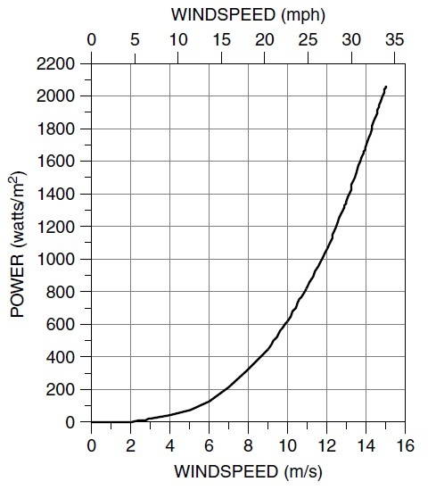
Power in the Wind
Power increases like the cube of wind speed
Doubling the wind speed increases the power by eight
Energy in 1 hour of 20 mph winds is the same as energy in 8 hours of 10 mph winds
Nonlinear, so we cannot use average wind speed
Notes:
54

Slide 55
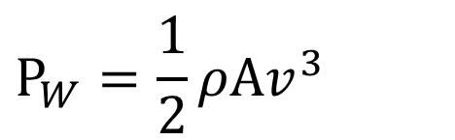
Power in the Wind
Power in the wind is also proportional to A
For a conventional HAWT, A = (π/4)D², so wind power is proportional to the blade diameter squared
Cost is roughly proportional to blade diameter
This explains why larger wind turbines are more cost effective
$$P_{W}=\frac{1}{2}ρAv^{3}$$
Notes:
55

Slide 56
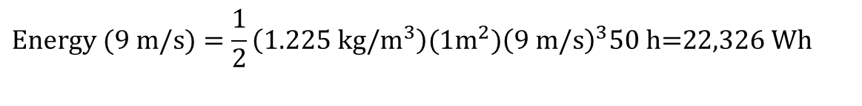
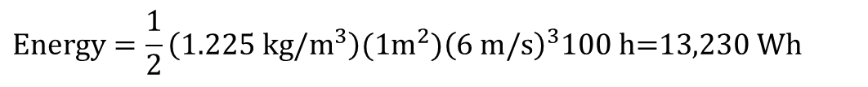
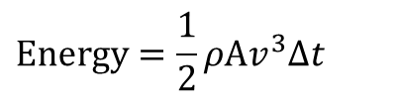
Example 7.1 – Energy in 1 m² of Wind
100 hours of 6 m/s winds
50 hours of 3 m/s winds and 50 hours of 9 m/s winds - *the average windspeed is 6 m/s
$$\text{Energy}=\frac{1}{2}ρAv^{3}Δt$$
$$\text{Energy}=\frac{1}{2}\left(1.225 \text{kg}\text{/}{\text{m}}^{3}\right)(1m^{2}){\left(6 \text{m}\text{/}\text{s}\right)}^{3}100 \text{h}\text{=13,230 }\text{Wh}$$
$$\text{Energy} (\text{3 }\text{m}\text{/}\text{s})=\frac{1}{2}\left(1.225 \text{kg}\text{/}{\text{m}}^{3}\right)(1m^{2}){\left(\text{3 }\text{m}\text{/}\text{s}\right)}^{3}50 \text{h}\text{=827 }\text{Wh}$$
$$\text{Energy} (\text{9 }\text{m}\text{/}\text{s})=\frac{1}{2}\left(1.225 \text{kg}\text{/}{\text{m}}^{3}\right)(1m^{2}){\left(\text{9 }\text{m}\text{/}\text{s}\right)}^{3}50 \text{h}\text{=22,326 }\text{Wh}$$
Notes:
56

Slide 57
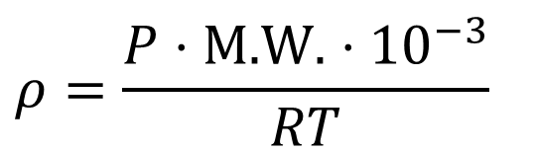
Air Density for Different Temperatures and Pressures
P = absolute pressure (atm)
M.W. = molecular weight of air (g/mol) = 28.97 g/mol
T = absolute temperature (K)
R = ideal gas constant = 8.2056·10⁻⁵·m³·atm·K⁻¹·mol⁻¹
Air density is greater at lower temperatures
$$ρ=\frac{P⋅\text{M}\text{.}\text{W}\text{.}⋅10^{−3}}{RT}$$
Notes:
57

Slide 58
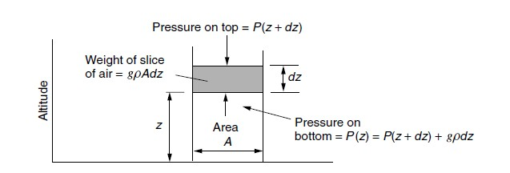
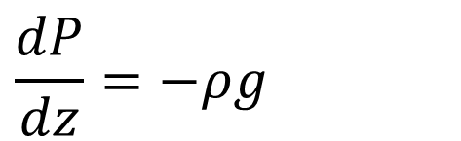

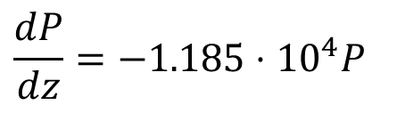
Air Density Altitude Correction
$$\frac{dP}{dz}=−ρg$$
$$dP=P(z+dz)−P(z)=−gρdz$$
Using 6.7, we get a differential equation in terms of pressure:
$$\frac{dP}{dz}=−1.185⋅10^{4}P$$
$$P=1 \text{atm}⋅e^{−1.185⋅10^{4}H}$$
where H is in meters
Notes:
58

Slide 59
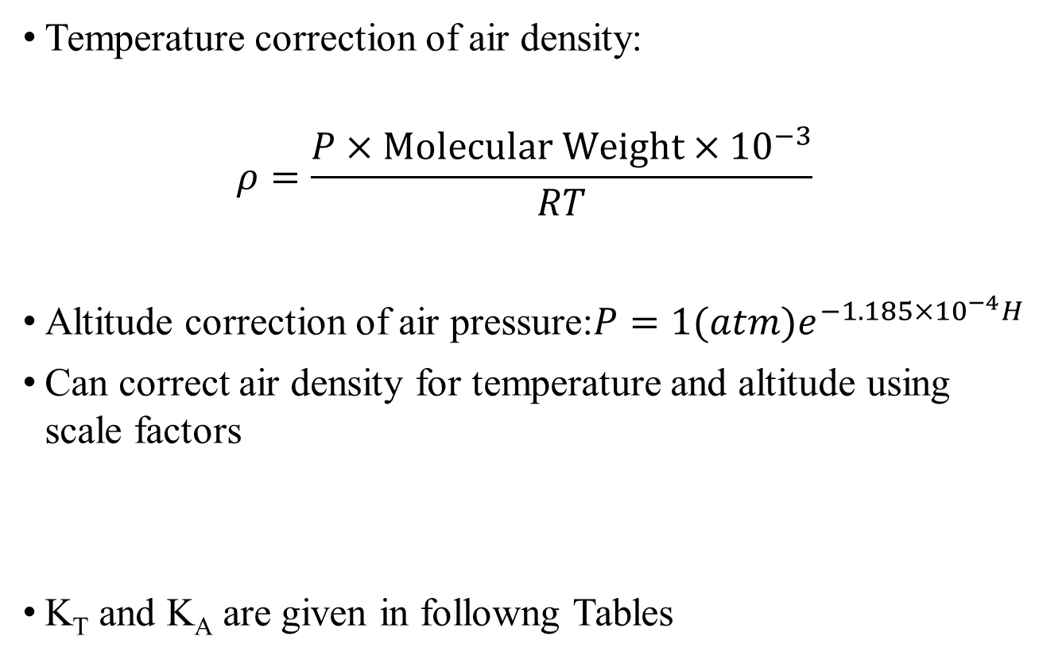

Air Density Correction Factors
Temperature correction of air density:
$$ρ=\frac{P×\text{Molecular} \text{Weight}×10^{−3}}{RT}$$
Altitude correction of air pressure:$P=1(atm)e^{−1.185×10^{−4}H}$
Can correct air density for temperature and altitude using scale factors
K_{T} and K_{A} are given in followng Tables
$$ρ=1.225K_{T}K_{A}$$
Notes:
59

Slide 60
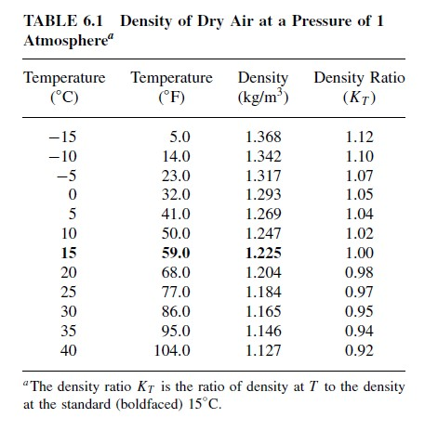
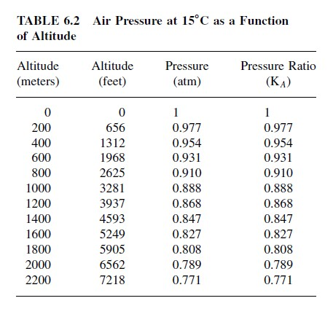
Air Density Correction Factors

Slide 61
Simple Rule of Thumb
Annual Energy (kWh) = 1.64 D2 Vavg3
D = rotor diameter, meters
Vavg = annual average wind speed (m/sec)
Why using average wind speed is a poor approximation of site potential
Let’s consider the following:
  What is energy in 200 hours of 7m/s wind?
  Compare with energy in 100 hours of 4m/s and 100 hours at 10m/s
  (NOTE: both average 7m/s)?

Slide 62
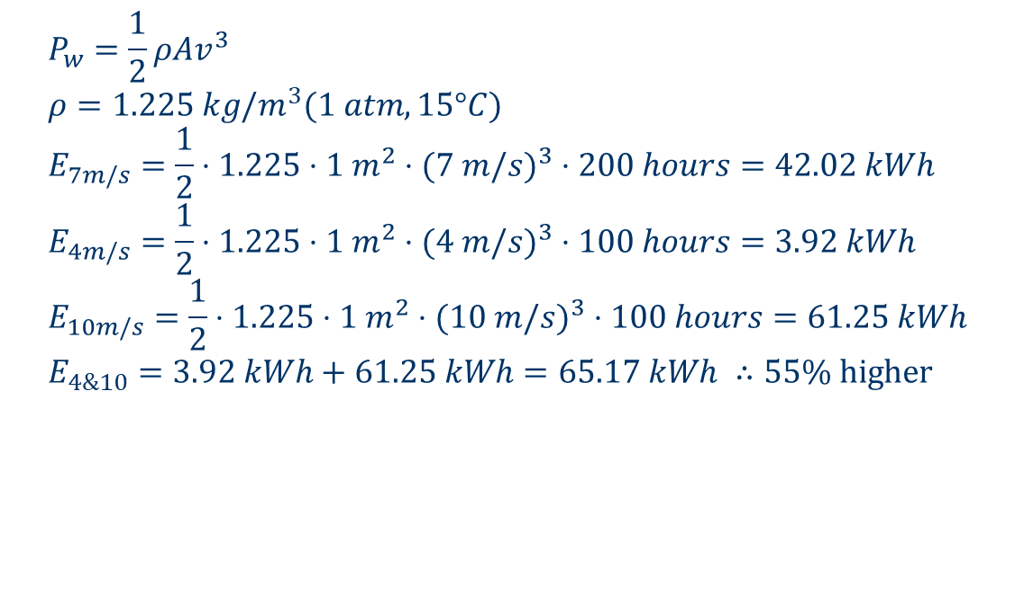
Power in the Wind
$$P_{w}=\frac{1}{2}ρAv^{3} \\ ρ=1.225 kg/m^{3}(1 atm, 15°C) \\ E_{7m/s}=\frac{1}{2}⋅1.225⋅1 m^{2}⋅(7 m/s)^{3}⋅200 hours=42.02 kWh \\ E_{4m/s}=\frac{1}{2}⋅1.225⋅1 m^{2}⋅(4 m/s)^{3}⋅100 hours=3.92 kWh \\ E_{10m/s}=\frac{1}{2}⋅1.225⋅1 m^{2}⋅(10 m/s)^{3}⋅100 hours=61.25 kWh \\ E_{4\&10}=3.92 kWh+61.25 kWh=65.17 kWh ∴55\% \text{higher}$$
Notes:
62

Slide 63
Impact of Tower Height
Power in the wind is proportional to the cube of the wind speed, so install the turbines on taller tower can increase the power generated.
wind speed is greatly affected by the friction that the air experiences as it moves across the earth’s surface.

Slide 64
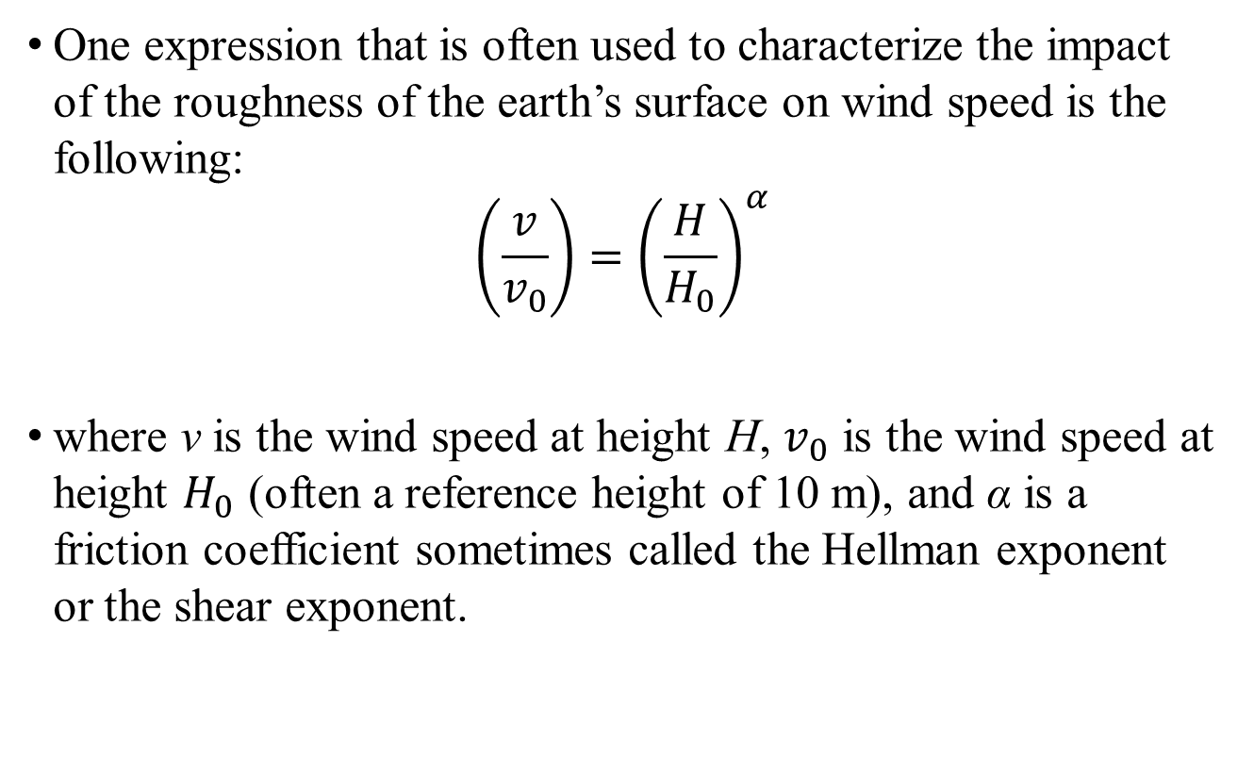
Impact of Tower Height
One expression that is often used to characterize the impact of the roughness of the earth’s surface on wind speed is the following:
$$\left(\frac{v}{v_{0}}\right)={\left(\frac{H}{H_{0}}\right)}^{α}$$
where v is the wind speed at height H, $v_{0}$ is the wind speed at height $H_{0}$ (often a reference height of 10 m), and α is a friction coefficient sometimes called the Hellman exponent or the shear exponent.

Slide 65

Impact of Tower Height
Some representative values for different terrain types

Slide 66


Impact of Tower Height
There is another approach that is more common in Europe:
$$\left(\frac{v}{v_{0}}\right)=\frac{\ln\left(H/l\right)}{\ln\left({H_{0}}/l\right)}$$
where l is called the roughness length.

Slide 67


Impact of Tower Height
The relative power of the wind at height H versus the power at the reference height of $H_{0}$:
$$\frac{P}{P_{0}}={\left(\frac{v}{v_{0}}\right)}^{3}={\left(\frac{H}{H_{0}}\right)}^{3α}$$

Slide 68
Wind Turbine Power Curves
Energy conversion technologies have fundamental efficiency limits:
Heat engines, Carnot cycle (typical 65%)
Fuel cells, Gibbs free energy (83%)
PV: the material band gap limits the conversion eff from sunlight into elec. energy
Wind turbine?

Slide 69
Maximum Theoretical Rotor Efficiency
Max theoretical is called Betz efficiency
Albert Betz 1919 - There must be some ideal slowing of the wind so that the turbine extracts the maximum power
For typical turbines this is 59.3%
Under ideal conditions today’s turbines can achieve 80% of the max theoretical:
  So many turbines range between 45-50%

Slide 70
Max theoretical rotor efficiency
Max theoretical Betz efficiency derivation:
Imagine what must happen to the wind as it passes thru a WT?
Two extreme cases, and neither makes sense-
Downwind velocity is zero – turbine extracted all of the power
Downwind velocity is the same as the upwind velocity – turbine extracted no power
Wind speed cannot be zero (which corresponds to the case all energy upwind are captured)
Wind speed cannot be the same as speed upwind (which corresponds to the case zero energy upwind are captured)

Slide 71

Maximum Rotor Efficiency
Constraint on the ability of a wind turbine to convert kinetic energy in the wind into mechanical power
Think about wind passing though a turbine- it slows down and the pressure is reduced so it expands

Slide 72
Suppose
Find the maximum value

Slide 73

Power Extracted by The Blades
ṁ = mass flow rate of air within stream tube
v = upwind undisturbed windspeed
v_{d} = downwind windspeed
$$P_{b}=\frac{1}{2}\dot{m}\left(v^{2}−{v_{d}}^{2}\right)$$
From the difference in kinetic energy between upwind and downwind air flows and (7.5)

Slide 74
Determining Mass Flow Rate
Easiest to determine at the plane of the rotor because we know the cross sectional area A
Then, the mass flow rate from (7.6) is
Assume the velocity through the rotor v_{b} is the average of upwind velocity v and downwind velocity v_{d}:

Slide 75

Power Extracted by the Blades
Then (7.21) becomes
$$P_{b}=\frac{1}{2}ρA\left(\frac{v+v_{d}}{2}\right) \left(v^{2}−{v_{d}}^{2}\right)$$
Define
$$λ=\frac{v_{d}}{v}$$
Rewrite (7.23) as
$$P_{b}=\frac{1}{2}ρA\left(\frac{v+λv}{2}\right) \left(v^{2}−λ^{2}v^{2}\right)$$

Slide 76
Power Extracted by the Blades
P_{W} = Power in the wind
C_{P} = Rotor efficiency

Slide 77
Maximum Rotor Efficiency
Find the speed windspeed ratio λ which maximizes the rotor efficiency, C_{P}
From the previous slide
Set the derivative of rotor efficiency to zero and solve for λ:
maximizes rotor efficiency

Slide 78
Maximum Rotor Efficiency
Plug the optimal value for λ back into C_{P} to find the maximum rotor efficiency:
The maximum efficiency of 59.3% occurs when air is slowed to 1/3 of its upstream rate
Called the “Betz efficiency” or “Betz’ law”

Slide 79

Maximum Rotor Efficiency
Rotor efficiency C_{P} vs. windspeed ratio λ
Modern WT blades can approach 80% of the Betz Limit; i.e., 45~50% efficiency in converting wind power into mechanical power of the rotating generator shaft.
Max occurs when upstream
wind is slowed down to 1/3

Slide 80

Tip-Speed Ratio (TSR)
Efficiency is a function of how fast the rotor turns
Tip-Speed Ratio (TSR) is the linear speed of the outer tip of the blade divided by windspeed
$$\text{Tip}\text{−}\text{Speed}\text{−}\text{Ratio} (\text{TSR})=\frac{\text{Rotor} \text{tip} \text{speed} (m/s)}{\text{Wind} \text{speed} (m/s)}=\frac{\text{rpm}×πD}{\text{60}v}$$
D = rotor diameter (m)
v = upwind undisturbed windspeed (m/s)
rpm = rotor speed, (revolutions/min)

Slide 81

Tip-Speed Ratio (TSR) – Max Theoretical Rotor Efficiency
TSR for various rotor types
Rotors with fewer blades reach their maximum efficiency at higher tip-speed ratios

Slide 82
Example
How fast does a big wind turbine turn? A 40-m diameter three-bladed wind turbine produces 600 kW at a wind speed of 14 m/s. Air density is the standard 1.225 kg/m³. Under these conditions,
(1) At what rpm does the rotor turn when it operates with a TSR of 4.0?
(2) What is the tip speed of the rotor?
(3) If the generator needs to turn at 1800 rpm, what gear ratio is needed to match the rotor speed to the generator speed?
(4) What is the efficiency of the complete wind turbine (blades, gear box, generator) under these conditions?

Slide 83
Example
a. Find the rpm of the rotor if it operates at a TSR of 4.0
Rewriting (7.30),
We can also express this as seconds per revolution:

Slide 84
Example
b. Tip speed
From (7.30):
TSR = v_tip / V_wind
c. Gear Ratio

Slide 85
Example
d. Efficiency of the complete wind turbine (blades, gear box, generator) under these conditions
From (6.4):
Overall efficiency:

Slide 86

Idealized Power Curve
One of the key pieces of information that manufacturers provide for their wind turbines is a graph showing the relationship between wind speed and electrical power expected from the complete system, including blades, gearbox, and generator.

Slide 87
Idealized Power Curve
Before the cut-in windspeed, no net power is generated
Then, power rises like the cube of windspeed
After the rated windspeed is reached, the wind turbine operates at rated power (sheds excess wind)
Three common approaches to shed excess wind
  Pitch control – physically adjust blade pitch to reduce angle of attack
  Stall control (passive) – blades are designed to automatically reduce efficiency in high winds
  Active stall control – physically adjust blade pitch to create stall

Slide 88
Idealized Power Curve
Above cut-out or furling windspeed, the wind is too strong to operate the turbine safely, machine is shut down, output power is zero
“Furling” –refers to folding up the sails when winds are too strong in sailing
Rotor can be stopped by rotating the blades to purposely create a stall
Once the rotor is stopped, a mechanical brake locks the rotor shaft in place

Slide 89

Practical Wind Turbine Power Curve
(Impact of Turbine Size on Power Curve)
A representation of power curves of turbines of different sizes from the manufacturer

Slide 90

IEC Wind Turbine Classification
Power curves and calculated efficiency. (a) Vestas V82-1.65, active-stall, squirrel-cage induction generator (SCIG). (b) GE 2.5-103, permanent-magnet, synchronous generator (PMSG) with full-capacity power converter. Note the different shapes of their efficiency curves.

Slide 91
IEC Wind Turbine Classification
TABLE 7.3 IEC 61400-1 Wind Classifications
Wind Turbine Generator Class | I | II | III
V_{avg} Average wind speed at hub height (m/s) | 10 | 8.5 | 7.5
V_{ref} 50-year maximum 10-minute wind speed (m/s) | 50 | 42.5 | 37.5
V_{e50} 50-year extreme 3-second gusts (m/s) | 70 | 59.5 | 53.5
Turbulence Class A | 16% | 16% | 16%
Turbulence Class B | 14% | 14% | 14%
Turbulence Class C | 12% | 12% | 12%
The International Electrotechnical Commission (IEC) is a nongovernmental organization that establishes safety standards for a wide range of electric technologies, including wind energy system.

Slide 92

Measuring the Wind
Anemometer is utilized to gather enough site. So, the collected wind information can be used for safe operation and to more accurately predict their performance and financial value.
The following are several different anemometer type:

Slide 93
Speed Control
Necessary to be able to shed wind in high-speed winds
Rotor efficiency changes for different Tip-Speed Ratios (TSR), and TSR is a function of windspeed
To maintain a constant TSR, blade speed should change as windspeed changes
A challenge is to design machines that can accommodate variable rotor speed and fixed generator speed

Slide 94
Wind Turbine Speed Control for Maximum Power
Recall: rotor efficiency Cp depends on the tip-speed ratio, TSR (Best region: TSR 4~6). So for maximum efficiency, rotor blades should change their speed as the wind speed changes.
Figure below shows speed control by three discrete rotor rpm steps.
30 rpm
40 rpm
20 rpm

Slide 95
Wind Turbine Speed Control for Maximum Power
Figure below shows Power delivered at three discrete rotor rpm steps.
40 rpm
30 rpm
20 rpm

Slide 96
Wind Turbine Speed Control for Maximum Power
It is difficult to maintain a fixed generator speed on a high efficiency level.
Pole-changing induction generator: 2-pole, 60 Hz→ 3600 rpm; 4-pole → 1800 rpm; so changing stator poles can give several discrete rotor rpm steps.
Multiple gearboxes: Some wind turbines have 2 gearboxes: low windspeed gear ratio and generator, and high windspeed gear ratio and generator.
Variable-slip induction generator: Adjusting variable resistance externally connected to the rotor can allow slip range 1% ~10%. (need wound rotor Ind. Generator with slip rings and brushes). Another way: physically mount the resistors and electronics on the rotor and send control signals to rotor to change slip (Opti Slip® with an optical fiber link to the rotor)

Slide 97
Pole-Changing Induction Generators
Being able to change the number of poles allows you to change operating speeds
A 2 pole, 60 Hz, 3600 rpm generator can switch to 4 poles and 1800 rpm
Can do this by switching external connections to the stator and no change is needed in the rotor
Common approach for 2-3 speed appliance motors like those in washing machines and exhaust fans

Slide 98
Variable-Slip Induction Generators
Purposely add variable resistance to the rotor
External adjustable resistors - this can mean using a wound rotor with slip rings and brushes which requires more maintanance
Mount resistors and control electronics on the rotor and use an optical fiber link to send the rotor a signal for how much resistance to provide

Slide 99

Variable Slip Example: Vestas V80 1.8 MW
The Vestas V80 1.8 MW turbine is
an example in which an induction generator is operated with variable rotor resistance (opti-slip).
Adjusting the rotor resistance changes the torque-speed curve
Operates between 9 and 19 rpm
Source: Vestas V80 brochure

Slide 100


Vestas
V80 1.8 MW

Slide 101

Indirect Grid Connection Systems
Wind turbine is allowed to spin at any speed
Variable frequency AC from the generator goes through a rectifier (AC-DC) and an inverter (DC-AC) to 60 Hz for grid-connection
Good for handling rapidly changing windspeeds

Slide 102

Example: GE 2.5 MW Turbines

Slide 103
Average Power in the Wind
How much energy can we expect from a wind turbine?
To figure out average power in the wind, we need to know the average value of the cube of velocity:
This is why we can’t use average windspeed v_{avg} to find the average power in the wind

Slide 104
Average Windspeed
v_{i} = windspeed (mph)
The fraction of total hours at v_{i} is also the probability that v = v_{i}

Slide 105
Average Windspeed
This is the average windpseed in probabilistic terms
Average value of v³ is found the same way:

Slide 106

So:
Wind Power:
$$P_{w}=\frac{1}{2}ρAV^{3}$$
Average Power:
$$P_{avg}={\left(\frac{1}{2}ρAV^{3}\right)}_{avg} \\ =\frac{1}{2}ρA(V^{3})_{avg} \\ ≠\frac{1}{2}ρA(V_{avg})^{3}$$

Slide 107

Example Windspeed Site Data

Slide 108
Wind Probability distribution concept
From wind monitoring project, for a year 8760 hours, we can measure wind speed and get a table:
Wind speed | Hours/yr | probability
0 | 25 | 25/8760
5 | 100 | 100/8760
7 . . . . ….. | 300 | 300/8760

Slide 109

Wind Probability Density Functions
Windspeed probability density function (p.d.f) – between 0 and 1, area under the curve is equal to 1

Slide 110
Windspeed p.d.f.
f(v) = windspeed p.d.f.
Probability that wind is between two windspeeds:
# of hours/year that the wind is between two windspeeds:

Slide 111
Average Windspeed using p.d.f.
This is similar to (6.33), but now we have a continuous function instead of discrete function
Same for the average of (v³)
discrete
continuous
discrete
continuous

Slide 112
Weibull p.d.f.
Starting point for characterizing statistics of windspeeds
k = shape parameter
c = scale parameter

Slide 113

Weibull p.d.f.
k=2 looks reasonable for wind
Weibull p.d.f. for c = 8

Slide 114
Rayleigh p.d.f.
This is a Weibull p.d.f. with k=2
Typical starting point when little is known about the wind at a particular site
Fairly realistic for a wind turbine site – winds are mostly pretty strong but there are also some periods of low wind and high wind

Slide 115

Rayleigh p.d.f. (Weibull with k=2)
Larger scale factor shifts the pdf curve towards higher windspeed
Higher c implies higher average windspeeds

Slide 116
Rayleigh p.d.f. -- Average speed and average power
When using a Rayleigh p.d.f., there is a direct relationship between average windspeed v and scale parameter c
Substitute (7.44) into (7.41):

Slide 117


Rayleigh p.d.f.
From (7.45), we can solve for c in terms of v
Then we can substitute this into the Rayleigh p.d.f (7.44) for c
$$f(v)=\frac{2v}{{\left(\frac{2\bar{v}}{\sqrt{π}}\right)}^{2}}⋅e^{\frac{−v^{k}}{{\left(\frac{2\bar{v}}{\sqrt{π}}\right)}^{k}}} \text{Rayleigh} \text{p}\text{.}\text{d}\text{.}\text{f}\text{. }(\text{7.46})$$
$$f(v)=\frac{πv}{2{\bar{v}}^{2}}⋅e^{−\frac{π}{4}{\left(\frac{v}{\bar{v}}\right)}^{2}} \text{Rayleigh} \text{p}\text{.}\text{d}\text{.}\text{f}\text{. }(\text{7.46})$$

Slide 118
Rayleigh Statistics – Average Power in the Wind
Can use Rayleigh statistics when all you know is the average windspeed
Anemometer
  Spins at a rate proportional to windspeed
  Has a revolution counter that indicates “miles” of wind that pass
  Dividing “miles” of wind by elapsed hours gives the average windspeed (miles/hour)
  “Wind odometer”
  About $200 each
  Easy to use

Slide 119
Rayleigh Statistics – Average Power in the Wind
Assume the wind speed distribution is a Rayleigh distribution
To find average power in the wind, we need (v³)_{avg}
From (7.42) and the Rayleigh p.d.f. (6.45):
Then for a Rayleigh distribution we have

Slide 120
Rayleigh Statistics – Average Power in the Wind
This is (v³)_{avg} in terms of c, but we can use (7.45) to write c in terms of v_{avg}
Then we have (v³)_{avg} in terms of v_{avg} :

Slide 121
Rayleigh Statistics – Average Power in the Wind
To figure out average power in the wind, we need to know the average value of the cube of velocity:
With Rayleigh assumptions, we can write the (v³)_{avg} in terms of v_{avg} as in (7.48), and the expression for average power in the wind is just
This is an important and useful result

Slide 122

Rayleigh Statistics – Average Power in the Wind
$$f(v)=\text{windspeed} \text{pdf} \\ \text{probability}(v_{1}≤v≤v_{2})=\int_{v_{1}}^{v_{2}}{f(v)dv} \\ \text{probability}(0≤v≤∞)=\int_{0}^{∞}{f(v)dv}=1$$
# The number of hours per year that the wind blows between any two speeds:
# Average wind speed:
# Average wind power:
# For Rayleigh pdf,

Slide 123
Example 7.6 – Average Power in the Wind
Estimate average power density in the wind at 50 m when the windspeed at 10 m has v_{avg} = 6m/s. Assume Rayleigh statistics, α=1/7, and ρ=1.225 kg/m³.

Slide 124
Example 7.6 – Average Power in the Wind
Estimate average power density in the wind at 50 m when the windspeed at 10 m has v_{avg} = 6m/s. Assume Rayleigh statistics, α=1/7, and ρ=1.225 kg/m³.
Estimate windspeed at 50 m:
Average power density in the wind at 50 m from (6.48):

Slide 125

Real Data vs. Rayleigh Statistics
This is why it is important to gather as much real wind data as possible

Slide 126
Wind Power Classifications
Wind Power Class | Average Speed m/s at 10m | Average Speed mph at 10m | 10-m Power Density W/m² | 50-m Power Density W/m²
1 | 0-4.4 | 0-9.8 | 0-100 | 0-200
2 | 4.4-5.1 | 9.8-11.4 | 100-150 | 200-300
3 | 5.1-5.6 | 11.4-12.5 | 150-200 | 300-400
4 | 5.6-6.0 | 12.5-13.4 | 200-250 | 400-500
5 | 6.0-6.4 | 13.4-14.3 | 250-300 | 500-600
6 | 6.4-7.0 | 14.3-15.7 | 300-400 | 600-800
7 | 7.0-9.5 | 15.7-21.5 | 400-1000 | 800-2000
Assuming ground friction coefficient 1/7, sea-level 0 degree C air density 1.225 kg/m3,
10 m anemometer height, 5-m hub height
North Dakota and Texas – high wind; TN, class 1

Slide 127
Wind Power Classification Scheme
Table 6.5
http://www.windpoweringamerica.gov/pdfs/wind_maps/us_windmap.pdf

Slide 128
Energy Potential for Class 3 or Higher Winds
Energy Potential for Class 3 or Higher Winds, in billion kWh/yr, Including Environmental and Land Use Constraints

Slide 129
Estimates of Wind Turbine Energy
Rotor blades Betz efficiency: 59.3%
Modern rotor: about ¾ of that potential
Gear box and generator converts about 2/3 of the shaft mechanical power created by the rotor into electricity
So, overall, about 30% conversion efficiency from wind power to electrical power.

Slide 130


Estimates of Wind Turbine Energy
Not all of the power in the wind is retained - the rotor spills high-speed winds and low-speed winds are too slow to overcome losses
Depends on rotor, gearbox, generator, tower, controls, terrain, and the wind
Overall conversion efficiency (C_{p}·η_{g}) is around 30%
Wind
Power in the Wind
Power to Electricity
Power Extracted by Blades
Rotor
Gearbox & Generator

Slide 131
Example – Annual Energy from a Wind Turbine
NEG Micon 750/48 (750 kW and 48 m rotor)
Tower is 50 m
In the same area, v_{avg} is 5m/s at 10 m
Assume standard air density, Rayleigh statistics, Class 1 surface, roughness coefficient alpha = 0.15; (total) efficiency is 30%
Find the annual energy (kWh/yr) delivered

Slide 132
Example - Annual Energy from a Wind Turbine
We need to use (6.16) to find v at 50 m, where z for roughness Class 1 is 0.03 m (from Table 6.4)
Then, the average power density in the wind at 50 m from (7.49) is

Slide 133
Example - Annual Energy from a Wind Turbine
The rotor diameter is 48 m and the total efficiency is 30%, so the average power from the wind turbine is
Then, the energy delivered in a year is

Slide 134
Rayleigh Probability Density Function
With the assumption of a Rayleigh distribution we have a very powerful analytical tool.
To calculate the number of hours in a given year we will experience wind above or below a certain level the process is quite simple:

Slide 135
Example
If we have a site where the wind speed (average) is 7 m/s and we assume a Rayleigh distribution, how many hours per year will the wind speed be less than 4 m/s (the cut in velocity for an NEG micon 1000/54 wind turbine)?

Slide 136
Solution
How many hours per year will the wind speed be less than 4 m/s?
0.2262 x 8760 = 1982 hours

Slide 137
Example
If we have a site where the wind speed (average) is 6 m/s and we assume a Rayleigh distribution, how many hours per year will the wind speed be less than 3 m/s?

Slide 138
Using this and a WT Power Spec
Combining these two we can predict effectively the power generated at any given site…

Slide 139



Wind speed cumulative distribution function
# The probability that the wind is less than some speed V:
$$Prob(speed v≤V)=F(v)=\int_{0}^{V}{f(v)dv} \\ ⇒C.D.F. \\ \left\{\begin{aligned}&F(0)=0 \\ &F(V)=prob(speed≤V) \\ &F(∞)=1\end{aligned}\right.$$
# Weibull pdf:
$$F(V)=\int_{0}^{V}{\frac{k}{c}{\left(\frac{v}{c}\right)}^{k−1}\exp\left[−{\left(\frac{v}{c}\right)}^{k}\right]dv} \\ \text{Let} x={\left(\frac{v}{c}\right)}^{k}, dx=\frac{k}{c}⋅{\left(\frac{v}{c}\right)}^{k−1}dv \\ ⇒F(v)=\int_{0}^{x}{e^{−x}dx} \\ ⇒F(V)=1−\exp\left[−{\left(\frac{V}{c}\right)}^{k}\right]$$
# Rayleigh: k=2,
$$c=2\bar{v}/\sqrt{π} \\ F(V)=1−\exp\left[−\frac{π}{4}{\left(\frac{V}{\bar{v}}\right)}^{2}\right]$$

Slide 140
Wind speed cumulative distribution function
Probability that the wind is greater than a certain speed value v:
# For weibull pdf
# For weibull pdf

Slide 141
Rayleigh PDF and Power Curve
1) build a spreadsheet
2) calculate hours at each speed (see below).
3) use manufacturers data for turbine generation at each wind speed
4) estimate annual generation

Slide 142
Example
What are the hours per year we will have wind speeds at 5, 6, 7 and 9 m/s if the average wind speed is 7 m/s?
Say wind speed at 5 m/s
where f(v) is pdf, which is not probability value.

Slide 143

Using Capacity Factor to Estimate Energy Produced
Capacity Factor (CF) as a function of V_avg has a linear region:
$$CF=0.087\bar{V}−\frac{P_{R} (kW)}{D^{2}}$$
(Rayleigh winds)

Slide 144
Example
Estimate energy production using CF approach: The Wisper H900 wind turbine has a 900-W generator with 2.13-m blades. Average wind speed is 6 m/s.

Slide 145
Example
Estimate energy production using C F approach: The Wisper H900 wind turbine has a 900-W generator with 2.13-m blades. Average wind speed is 6 m/s.
CF = 0.324
Year: 2554 kWh/yr

Slide 146
Wind Farms and Parks
What are good engineering design standards for efficient power extraction from a windy site?
Goals: maximize power output, minimize downstream turbulence and inefficiencies, optimize overall site utilization (cost of equipment, power output, maintenance)

Slide 147
Wind Farm Optimization
For farm output: higher density is better
For maintenance: higher density is better
For land costs: higher density is better
For reducing wind turbulence: lower density is better
For turbine output: lower density is better

Slide 148
Wind Farms
We know that wind slows down as it passes through the blades. Recall the power extracted by the blades:
Extracting power with the blades reduces the available power to downwind machines
What is a sufficient distance between wind turbines so that windspeed has recovered enough before it reaches the next turbine?

Slide 149
Wind Farm – Rules of Thumb
Recommended spacing:
  3-5 Rotor Diameter Spacing between towers within the same row
  5-9 Rotor Diameter Spacing between rows
  Stagger (offsetting) alternate rows downwind between upwind turbine “shadows”
Concept of “Array Efficiency”: the output power of the array of turbines divided by the power that would result if there were no interference between turbines.

Slide 150

Wind Farms – Array Efficiency
For closely spaced towers, efficiency of the entire array becomes worse as more wind turbines are added

Slide 151
Wind Farms
The study in Figure 6.28 considered square arrays, but square arrays don’t make much sense
Rectangular arrays with only a few long rows are better
Recommended spacing is 3-5 rotor diameters between towers in a row and 5-9 diameters between rows
Offsetting or staggering the rows is common
Direction of prevailing wind is common

Slide 152
Wind Farms
Normally, it makes sense to install a large number of wind turbines in a wind farm or a wind park
Benefits
  Able to get the most use out of a good wind site
  Reduced development costs
  Simplified connections to the transmission system
  Centralized access for operations and maintenance
How many turbines should be installed at a site?

Slide 153
Wind Farms
We know that wind slows down as it passes through the blades. Recall the power extracted by the blades:
Extracting power with the blades reduces the available power to downwind machines
What is a sufficient distance between wind turbines so that windspeed has recovered enough before it reaches the next turbine?

Slide 154
3~5 diameters
5~9 diameters

Slide 155


Wind Farms – Optimum Spacing
Ballpark
figure for
GE 1.5 MW in Midwest
is one per
80 acres
3 D to 5D
Figure 6.29
Optimum spacing is estimated to be 3-5 rotor diameters between towers and 5-9 between rows
5 D to 9D

Slide 156
Wind Farm Example – Wind Energy Potential per unit of land area
Suppose a wind farm has a 4 rotor diameter spacing along its front row and 7 rotor diameter spacing between rows. Assume 78% array efficiency and turbine efficiency of 32%.
  Find the annual production per acre for 400W/m² winds at hub height (the edge of 50m, Class 4 winds)
  If the farmer leases the land for $100/acre-year (which is 10x what he makes on cattle) what is the lease cost (for wind farm company) per kWh generated?

Slide 157
Example
Turbine
4D
7D
7D
4D
Area occupied by 1 turbine

Slide 158
Wind Farm Solution
  Find the annual production per acre for 400W/m² winds at hub height (one turbine consumes 28 D²)
(1 acre = 4047 m²)

Slide 159
Wind Farm Solution
  If the farmer leases the land for $100/acre-year (which is 10x revenue on cattle) what is the lease cost per kWh?

Slide 160
Example
What is the production potential (kWh/acre) of a Class 3 wind site (assume 350 W/m²) in an offshore wind farm site at 50-m hub height? Assume 3 x 6 spacing, 82% array efficiency and 28% turbine efficiency.
If the local state offers $200/year leases to offshore developers how much would these leases add to production costs (per kWh)?

Slide 161
Example
What is the production potential (kWh/acre) of a Class 4 and 5 wind sites (assume 450 and 550 W/m² respectively) in a wind farm site at 50-m hub height? Assume 3 x 6 spacing, 82% array efficiency and 28% turbine efficiency.

Slide 162
End

